Slide 1
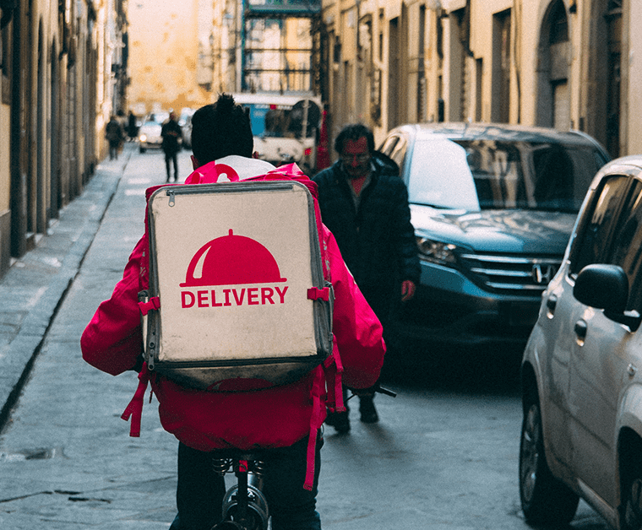

Food Delivery Service
Information System
Group-6
Akanksha Kottakota
Akhila Reddy Kondi
Sarmad Kiani
Syed Omar Farooq Ali
Abhimanyu Gangula

Slide 2
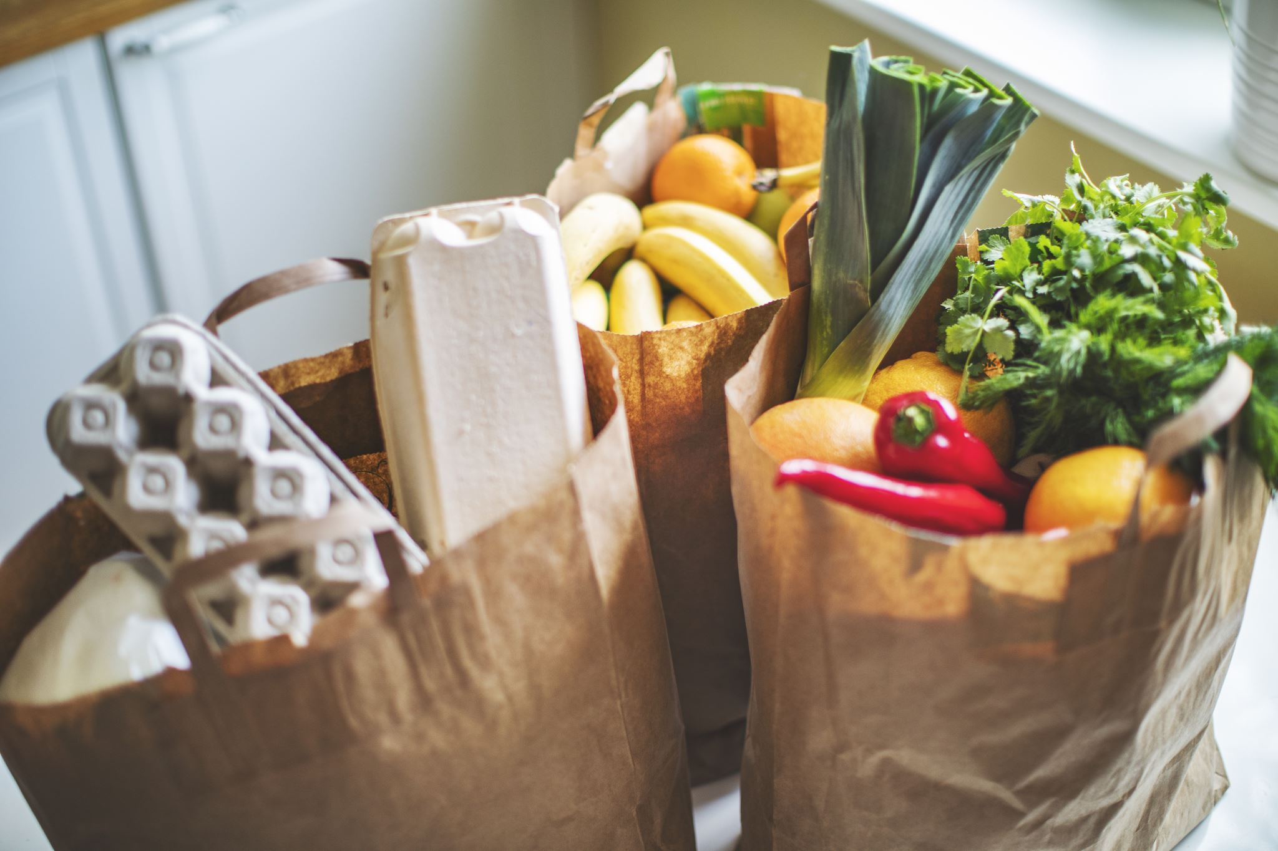
The Need For An Organized & Fast Paced Food Delivery System
For Restaurants: To be able to widen their reach and serve more consumers.
For Consumers: To be able to order their favorite food and get it delivered on time and at their convenience.
According to Statista, global revenue is estimated to show an annual growth rate (CAGR 2020-2024) of 7.5%, indicating a market volume of US$164,002M by 2024.

Slide 3
What Is A Food Delivery System?
It is an interface system
For Restaurants:
Provides an option to edit their menu
Alerts them about an order
Alerts about any special requests placed by the consumer
Helps receive on-time payments
Keeps a track of various transactions on a daily basis
Lets them know the agent assigned for delivery of the order
For Consumers:
Order food from various restaurants
Place any special requests regarding their order
Make easy, hassle-free payments
Contact the delivery agent and track their order if needed
Allows them to leave a review

Slide 4
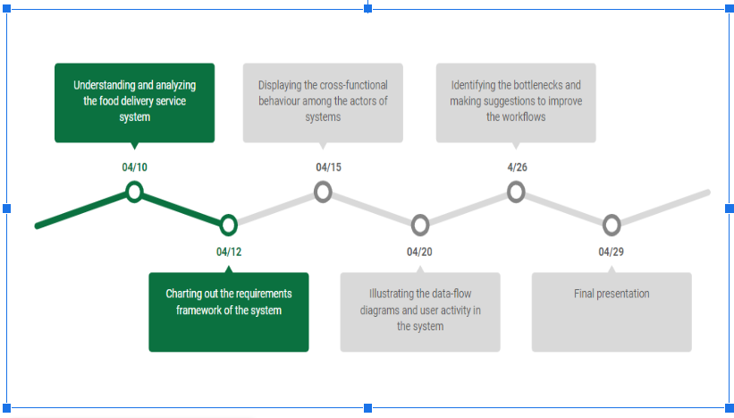
Schedule Of The Assessment Followed

Slide 5
Requirement Analysis
Step 1: Identifying Key Stakeholders and End-Users
These are following main actors in our system Customers/consumer
Restaurant (Merchant)
Delivery Agents (Drivers)
Admin (from the company)
Step 2: Capture Requirements
Hold One-on-One Interviews
Use Focus Groups

Slide 6
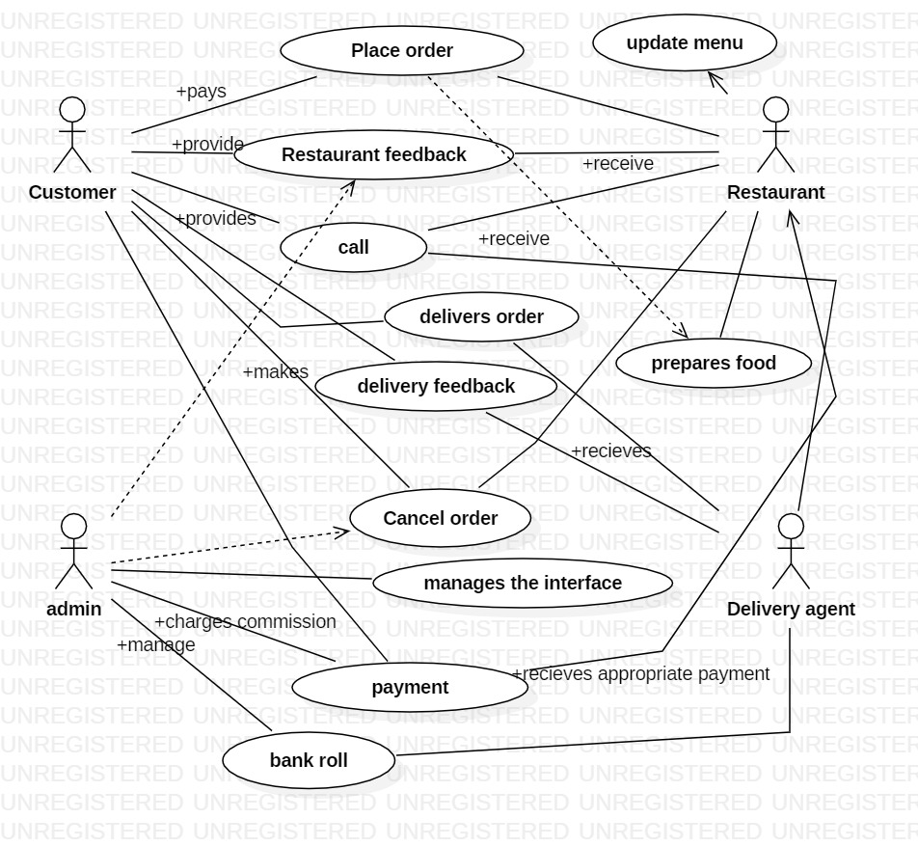
Functional Requirements
Customers should be able to:
Create a cart, add menu items to it, and then place an order.
Once an order has been placed, customers will be notified of its status.
On the app, customers may check the status of their order
Cancel the purchase.
Make a payment for the order.
Create an account for themselves and update their contact details.
Admin should be able to
Select which restaurants tobe included in the user-interface
Manage customers info and status
Monitor orders and info
Provide interactive interface between all the actors
Record order payments and deliveries
Take feedback from restaurants and delivery agents

Slide 7
Restaurants should be able to:
Set up their profile (onboarding), create/refresh/add new menu items, and upload photos.
Receive notifications regarding orders placed, delivery agent assigned, and order progress updates, among other things.
Take feedback about their orders from customers.
Offboarding: When a restaurant closes its doors or decides to stop accepting online orders.
Delivery Agents should be able to:
Receive updates about available orders in their region, which they can choose from.
When the order will be ready for pickup, they should be notified.
Any difficulties encountered during order pickup/delivery should be reported to the customer/restaurant.
If they don't wish to continue working, they can deregister.

Slide 8
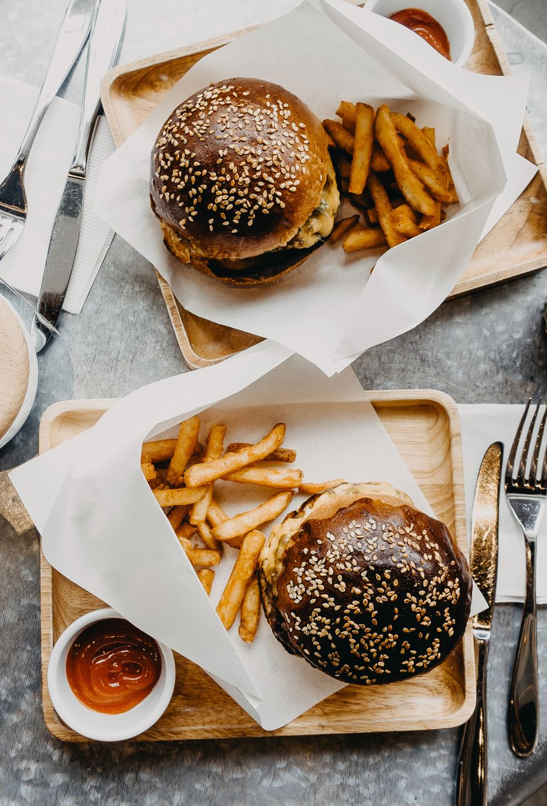
Non-functional Requirements
Latency: Hungry users would not want to wait to see the menu or restaurant specifics, so the search feature should be quick. The ordering experience should also not have high latency and must be seamless and fast.
Consistency: When an order is placed, however, the client, the restaurant, and the door dasher should all see the same order. As a result, in this situation, consistency is critical.
Seamless User Interface: The user should be able to use this delivery system without encountering any technical glitches.
Availability: High availability is desirable for the optimal customer experience, as well as for the restaurants handling the order and the food delivery agent. No restaurant wants their business to suffer because of a system failure; that's a significant financial loss.
High Throughput: The system should be able to handle high peak load without problems or failures.

Slide 9
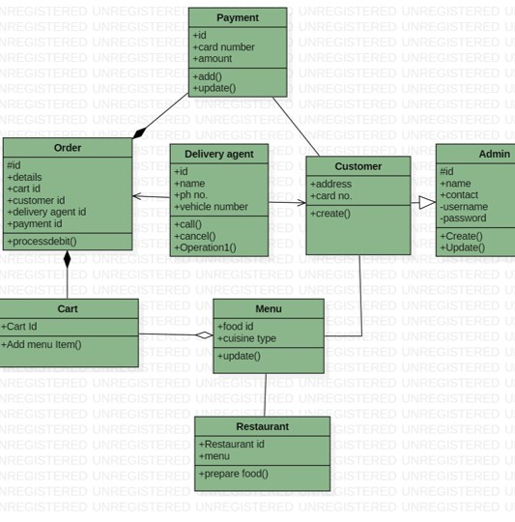
Class Diagram
As part of the food delivery system 8 main classes have been identified. They are as follows:
1)Restaurant
2) Menu
3)Cart
4) Customer
5) Order
6) Delivery agent
7) Payment
8) Admin

Slide 10
Use case Diagram
A customer can browse for the restaurants in the food delivery system and look through the different cuisines and food items present in the menus of the restaurants. The customer can then decide and place the order by making the payment.
The Restaurant receives the order from the food delivery system.
After the restaurant prepares the food it notifies the food delivery system which in turn assigns a delivery agent to that order. The delivery agent receives the details of the order. He/she then collects the prepared order from the restaurant and then delivers it to the customer.
The customer has an option to provide feedback for the restaurant regarding food and also provide feedback about the services provided by the delivery agent.
The restaurants can update the menu whenever they feel necessary.
The admin is in charge of handling the system. He manages the list of the restaurants associated with the food delivery system, interfaces between the various platforms and the payment systems.

Slide 11
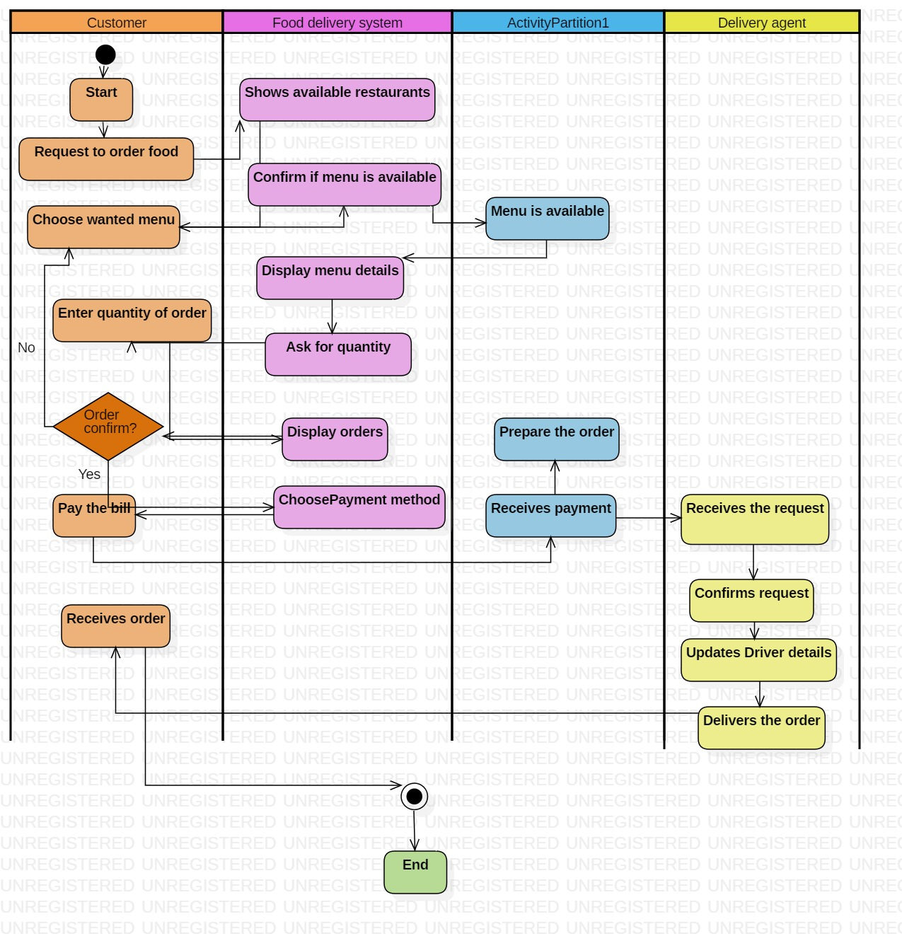
Activity Diagram
The activity diagram starts with the customer requesting to order food from restaurants linked with the food delivery system. Restaurant confirms if the menu items are available. The customer chooses from the menu provided by the restaurant and then makes the payment. The food service system assigns a delivery agent to the specific order. The delivery agent picks up the order from the restaurant and then delivers it to the customer. After this the delivery agent receives the payment from the system.

Slide 12
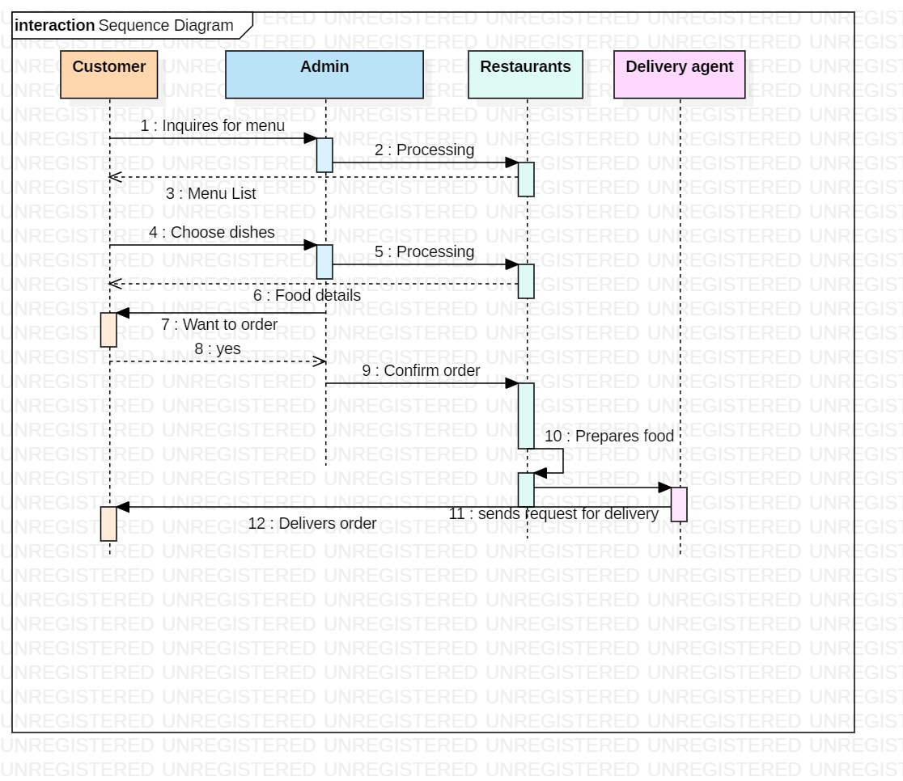
Sequence Diagram

Slide 13
Advantages:
Makes managing orders much simpler as the entire business is managed at one platform.
Urban Restaurants can reach out to remote customers with the online food delivery system in place, restaurants can be available to the remote food-lovers by being visible with its menu and providing the option to deliver in that area.
With the online food ordering system, customers get excellent deals for cash back and discount offers while ordering for delivery.
Restaurant owners can keep track of orders and deliveries. The online food delivery system also lends in increases of sales and revenue.
Generates daily and monthly sales reports so restaurant owners can see their profit graphs.

Slide 14
Challenges:
Customers placing orders for out-of-stock items as they weren’t synced with the online channels: Even after menu updates where items were marked out of stock. There have been technical issues where restaurants still got orders for those items as the menu didn’t update on time.
Food Safety , Tampering & Quality: Restaurants should be concerned about maintaining the correct hot and cold holding temperatures of the food they are delivering. When using a third party delivery service, they need to be aware of how the delivery orders will be held in your store until they are picked up by a driver and if they have the right equipment like a hot food holding cabinet.
The Logistics: The logistics challenges faced by food delivery systems are immense. Whether to keep the delivery radius restricted to a few areas or cater to wider geography, the scope of getting higher orders from a specific area, allocating the right number of vehicles, ensuring the food quality, etc. are some of the critical logistics-related issues that food delivery companies face.
Revenue conflicts between the restaurants and delivery providers: In case of technical issues like order cancellations or wrong delivery address etc., there are often payment disputes between all the 4 actors involved i.e. the restaurant, delivery service, delivery agent and the customers.
Customer Privacy & Data: Customers order on their cellphones and through food delivery apps like Uber Eats and Doordash. Sensitive data including credit card numbers is transmitted and frequently stored often across multiple networks and systems. If the restaurant service exposes customer data, customers will lose trust. Failure to comply with the law’s standards can open up a business to hefty fines and potential lawsuits.
Punching in delivery orders manually along with being on multiple online ordering platforms : By entering orders in the POS tab and sending tickets to kitchen, leads to losing time and making human errors which creates delay in the order flow moreover restaurants nowadays follow the concept of virtual/dark kitchens with multiple names on different platforms which lead to managing multiple tablets for each of them.

Slide 15
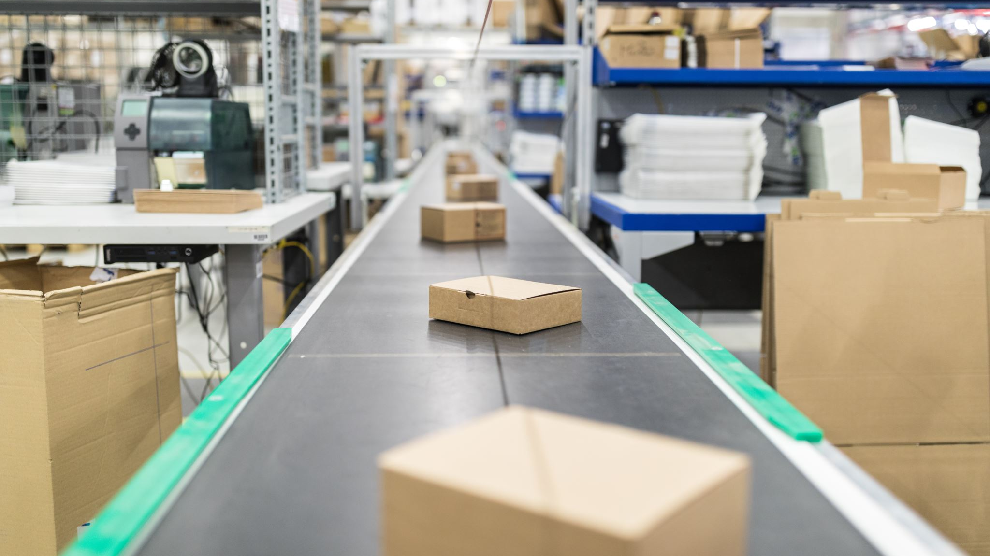
Solutions:
Even though modern POS systems include stock management, in order to sync with their online sales platforms, restaurants need an active POS integration. Real-time inventory data is the only way to guarantee correct product availability and reduce out-of-stock products so the restaurant does not get wrong orders.
As the delivery service has exploded, there have been many innovations into what is called “tamper evident packaging.” where the idea isn’t to make delivery containers into little puzzle boxes or portable safes as protection layer for the business and the customer. Take out bags can be sealed with an adhesive that will tear the bag if removed. Carryout containers can have plastic seals that have to be broken to remove the food and cannot be replaced or resealed once broken.
The best way to resolve this challenge is by integrating your food delivery platform with features like order scheduler, delivery router, location tracking, geo fencing, etc. Besides, providing the right training to the delivery personnel can also help to ensure timely deliveries.
Securing payment gateway by using a third-party payment processor, having an up-to-date SSL certificate and HTTPS protocol, using a firewall, updating plugins and software, using multi-layer security, encrypting data, utilizing data classification and segmentation. Moreover restaurants should be Aware of Data Privacy and Security Laws and Regulations and must implement appropriate polices and provide training.
To deal with punching orders manually, the entire online order process can be automated as the tickets could directly go into the kitchen saving up the staff’s time, so they can focus on improving the customer experience. For handling multiple stores, this issue can be dealt with by integrating the delivery orders into our POS system so the orders from different stores automatically come in one single tab and that can be pulled into the POS.

Slide 16

Conclusion:
Online food delivery system for a restaurant is a highly sophisticated system with a lot of moving objects at the same time.
It consists of many different processes to ensure better services to customers as well as a better business model for a restaurant.
In this analysis we depicted the process by outlining various UML diagrams for better understanding of the food delivery system.
While going through the process, we were surprised to know the amount of analysis required for these IT processes to be implemented and executed flawlessly along with holistic understanding.
While the UML Diagrams work together to achieve the most desired functions of an Online Food delivery System. It also helps us understand the behavior and structure of the Online Food Ordering System.
Starting to appreciate building large popular day-to-day applications is the ideal method to prepare for this type of design. Consider millions of users, massive datasets, failure points, transactions, and so on.

